Slide 1

Design and Analysis of FSAE Monocoque Chassis Frame
B.Tech. Project (ME-3082) – 7th semester
Date: 06-04-2024
Presented by: Group No. - AM02
Supervisor(s)
Prof. Isham Panigrahi
Deputy Director KIIT Student Research Center
Antarik Dutt | Roll No:2009002
School of Mechanical Engineering
KIIT, Bhubaneswar

Slide 2
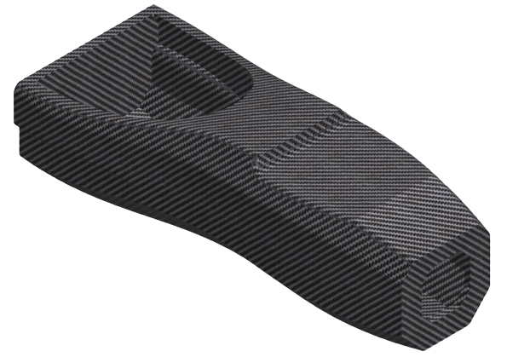
Table of contents
Chassis
Introduction
Literature review
Objectives
Problem definition
Calculation
Calculation of Torsional Stiffness
Calculation of Impact Test
Solid model Iterations
Force Analysis
Conclusion
Fig 1. FSAE Chassis

Slide 3
Literature Review
Author | Year | Contribution
Cunningham ET AL.. | 2015 | Ansys composite Parameters for Torsional Analysis
Carline ET AL. | 2020 | Material Selection of Carbon fibre and Honeycomb.
Leon ET A Rice. | 2019 | Composite Theory and appropriate number layers required to get desired torsional stiffness

Slide 4
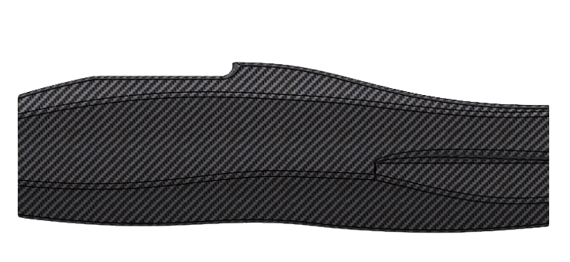
Introduction
Monocoque chassis provides a high level of structural integrity because the body itself contributes to the overall strength of the vehicle.
Monocoque chassis tends to be lighter than traditional body-on-frame designs because it eliminates the need for a separate frame.
Fig 2. FSAE Chassis for Comet

Slide 5
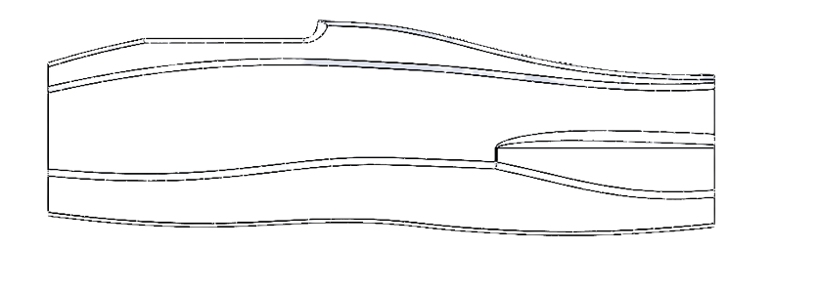
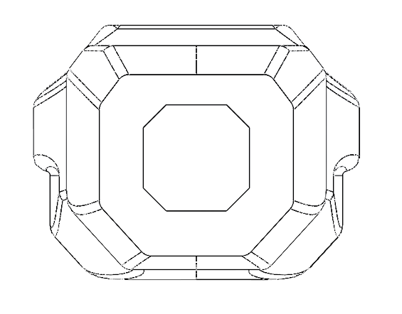
Objective
Objective
The aim of this project is to design and analyze a new FSAE chassis for the 2024 racing season. The team has been given the task of iterating on the successful FSAE 2022 car that went to competition.
Major goals include:
Conform to all FSAE chassis rules
To design a monocoque chassis which is light, has adequate stiffness and
should be compact.
Analyze the final design
Document the process for future designs

Slide 6
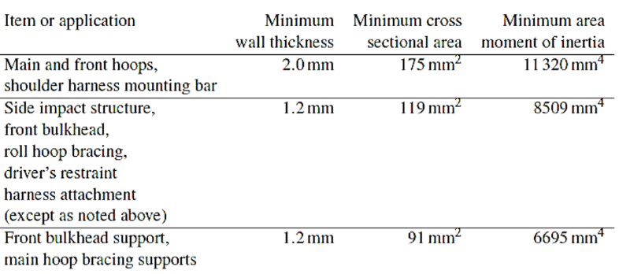
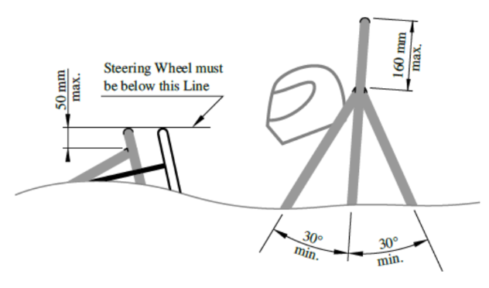
Problem definition
Tubing specifications - The dimensions of the tubing to be used for the frame are specified from rule T3.4 of the FSAE Rules.
Roll hoop dimensioning - The main and front roll hoop are to comply with rules T3.11 and T3.12 stating required hoop characteristics such as max angle from vertical, bend requirements, and minimum dimensions.
Bracing - The bracing for the main and front roll hoops are explicitly stated in rules T3.13 and T3.14 describing the requirements for bracing angle and dimensions.

Slide 7
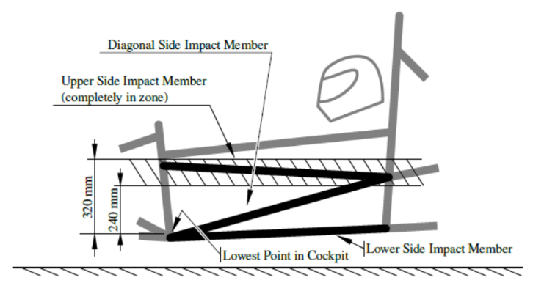
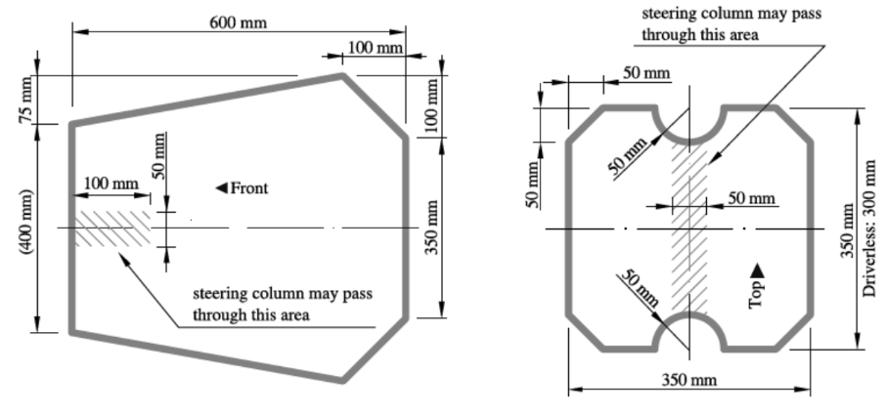
Problem definition
Clearance - The minimum requirements for helmet clearance from the frame is given in rule T3.10 describing the need to fit a 95th percentile male template .
Side impact structure - The side structure of the car must comply with rule T3.24 which places restrictions on tubing size used along with tubing placement.
Cockpit - The dimensions of the cockpit must comply with rule T4.1 and is required to pass the test at the competition. The cockpit must also meet rule T4.2 which gives a predefined cross section that must remain clear inside the vehicle. The driver must also be able to safely and quickly exit the cockpit by rule T4.8.

Slide 8
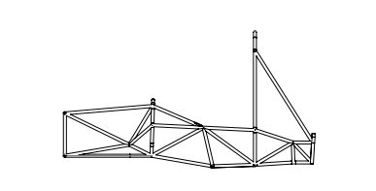
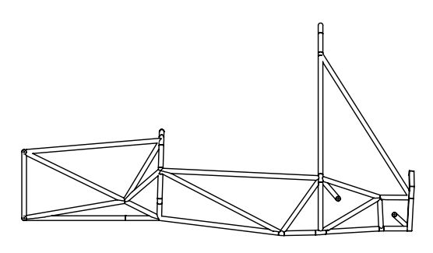
Comparison
Space Frame Chassis 1
Weight - 32439 gram
Torsional Stiffness - 968.72 Nm/deg
Space Frame Chassis 2
Weight - 29076.91 gram
Torsional Stiffness - 838.125 Nm/deg
Monocoque chassis Frame
Weight - 25906.31 gram
Torsional Stiffness - 1432.460 Nm/deg

Slide 9
Features of the Chassis
Features | Values of present chassis frame | Values of previous chassis frame | Percentage Decrease
Kerb Weight | 25.90 Kg | 29.07 Kg | 10.90%
Torsional Stiffness | 1432.460 Nm/deg | 838.125 Nm/deg | 41.49%
Weight Distribution | 50:50 (Left - Right) | 50:50(Left - Right) | NA

Slide 10
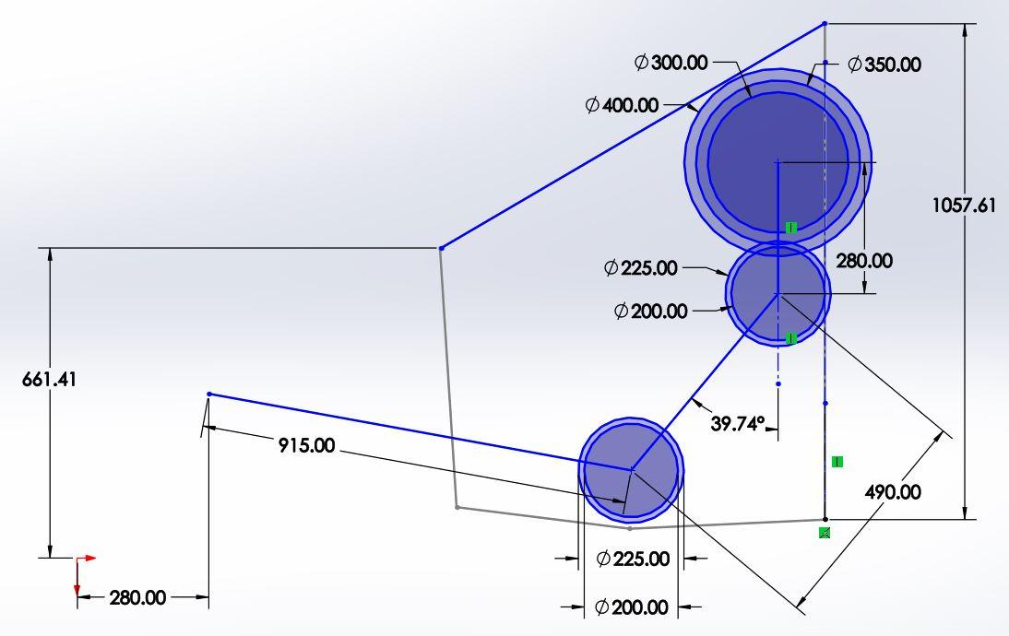
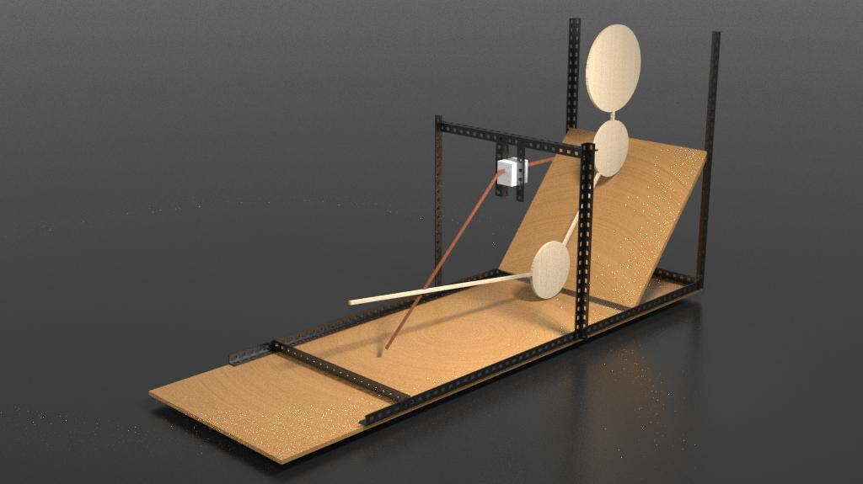
Ergonomics

Slide 11
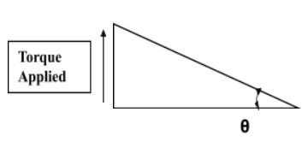
Calculations
Calculation of Torsional Stiffness
The horizontal distance between the center of the chassis and point of application of force is 2mm.The force applied this time for the analysis is 5000N. The maximum deformation in Y-axis obtained from the ANSYS is 2.1317 mm.
Calculations:
So the angle of displacement for the first case are as follow:-
θ = tan-1(2.1317/552.595) = 0.003857
So now the net torque applied is:-
T = Force*Distance
Torque = 5000*0.5525*2
= 5525Nm
So the torsional stiffness can be found by:-
=T /(Angular displacement= θ)
= 5525/0.003857
= 1432.460 Nm/deg

Slide 12
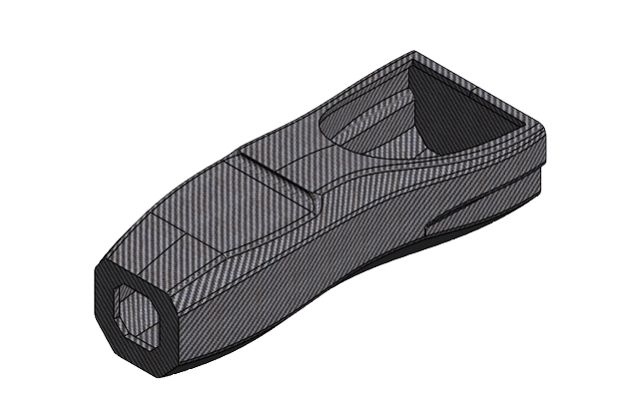

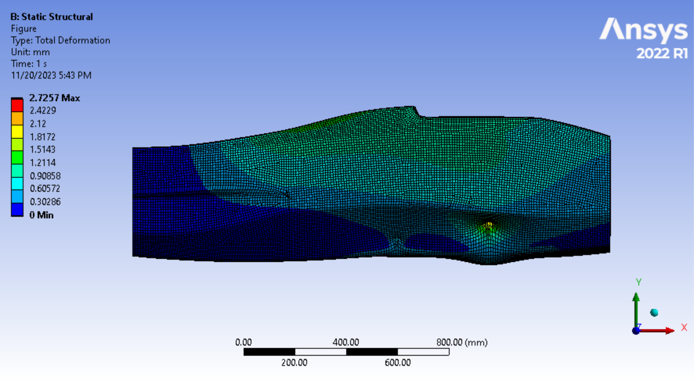
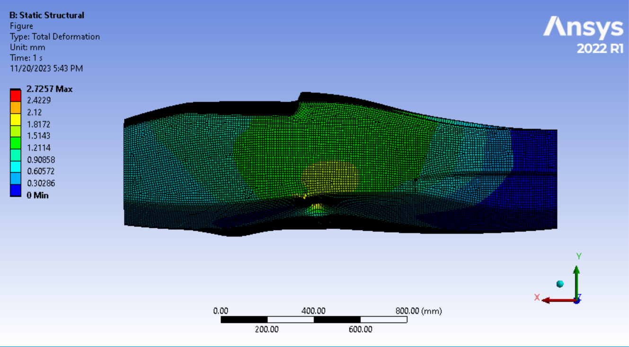
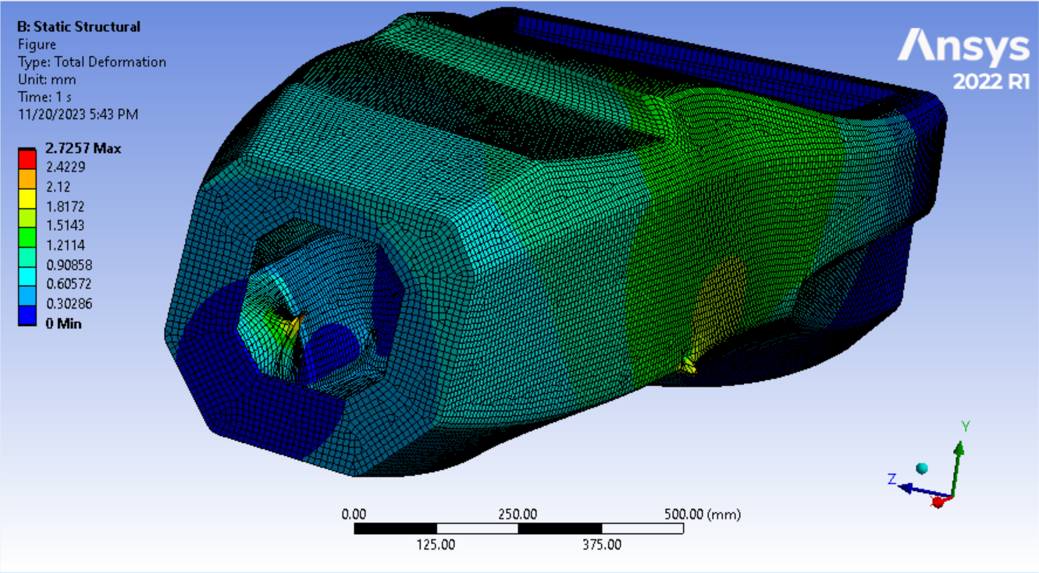
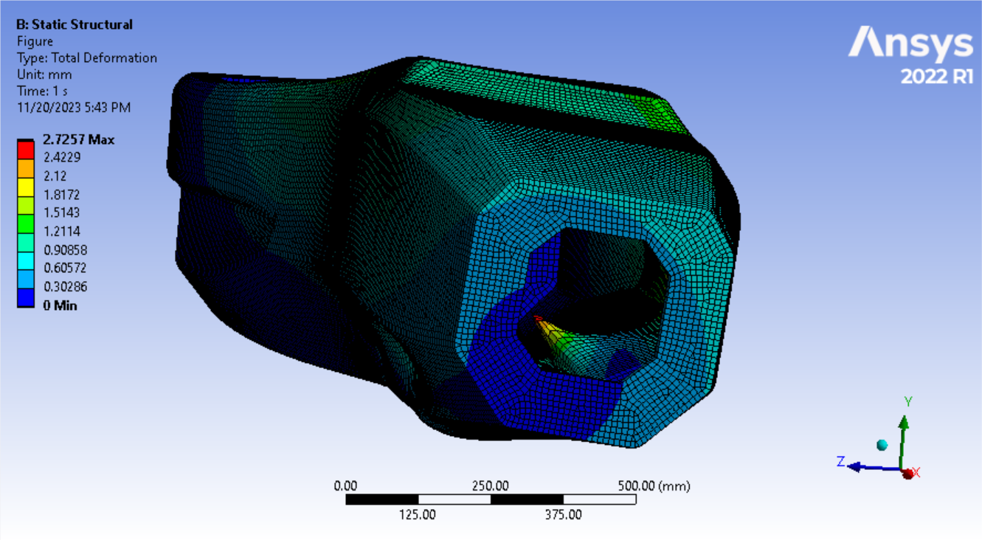
Analysis of Torsional Stiffness
Total Deformation
Fixed nodes
Direction of force

Slide 13
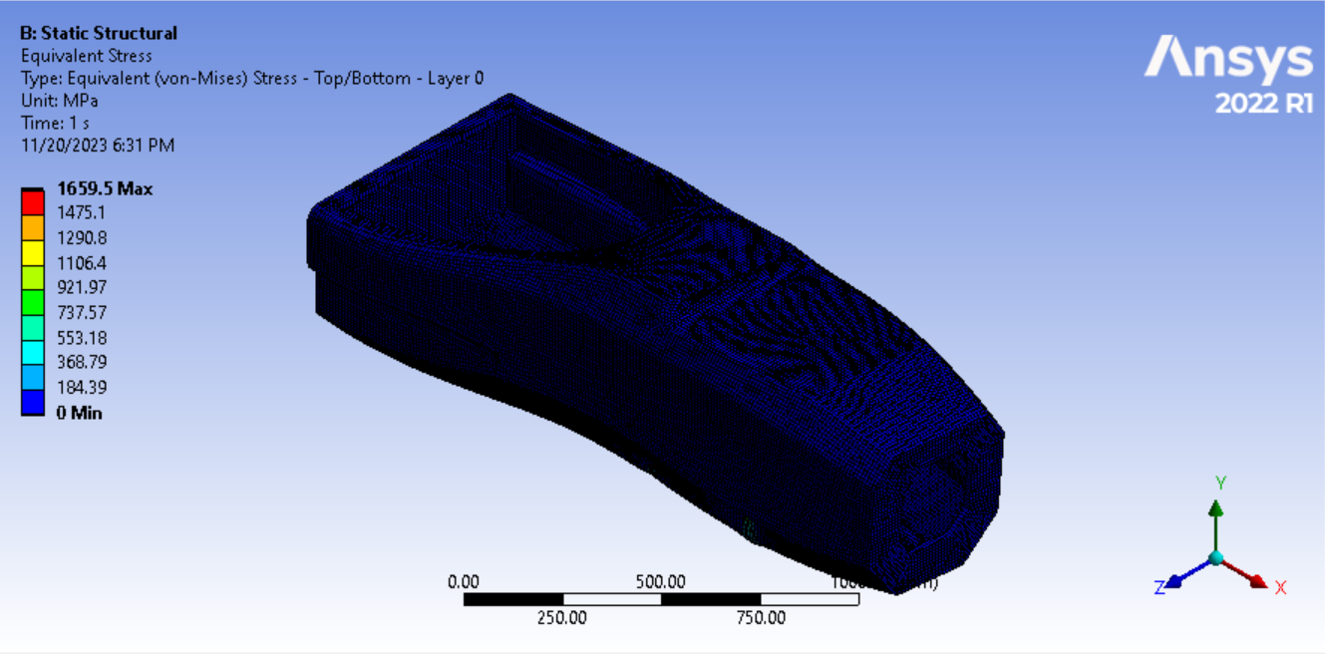
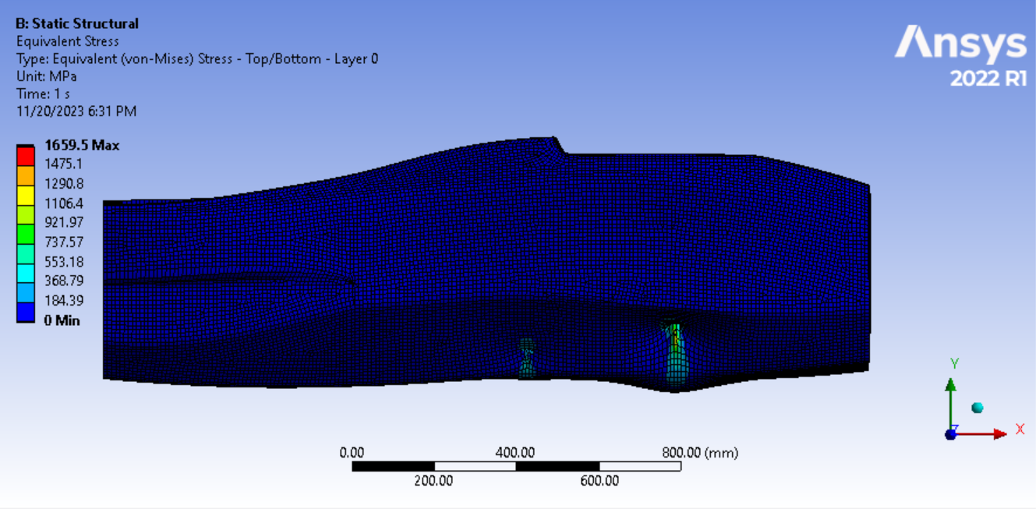
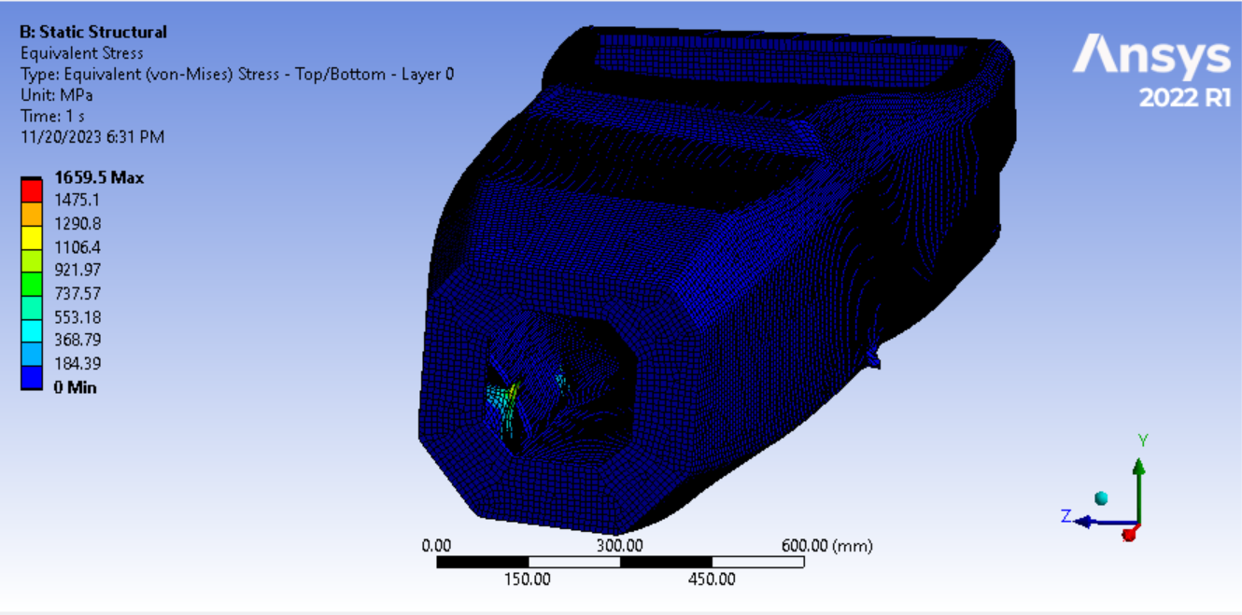
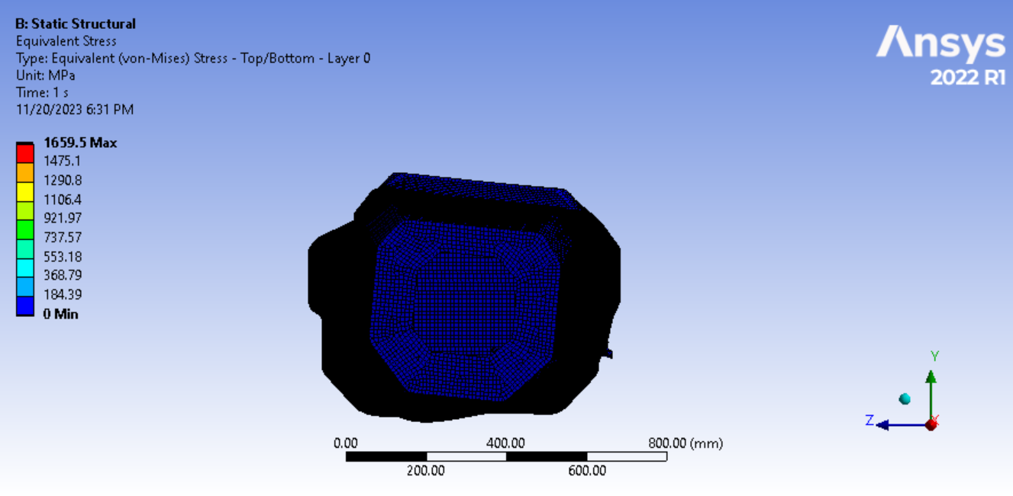
Equivalent Stress
Torsional Stiffness: 1432.460 Nm/deg

Slide 14
Analysis of Frontal Impact
Mass of the Vehicle= 246 Kg
Velocity of the Vehicle= 22.22m/s or 80Km/h
Impact Force = Mass * (dv/dt)
= 246 * (22.22 - 0)
= 5466.12 N
To be on the safer side we have taken an additional factor of safety as 4 and the force which will then be considered was found out to be 21864.48N

Slide 15
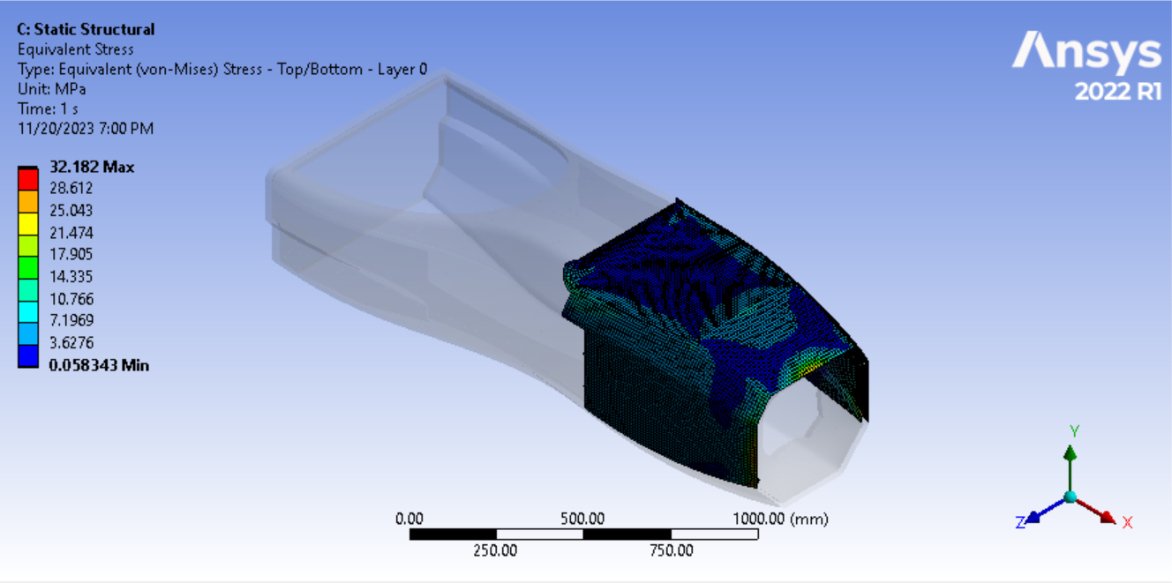
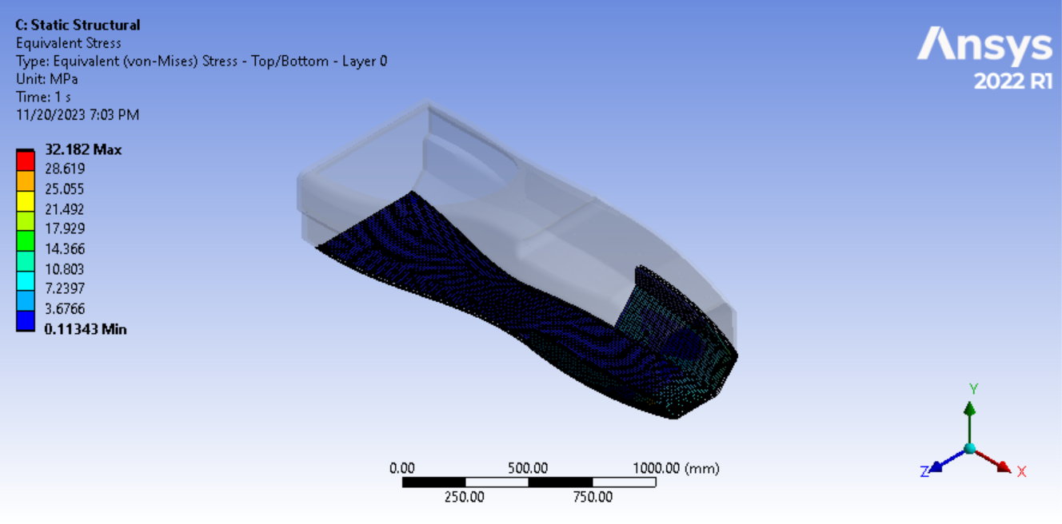
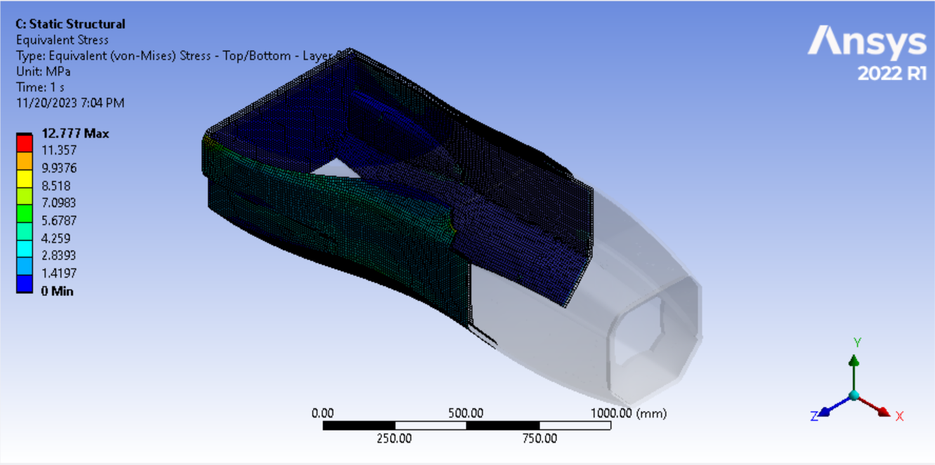
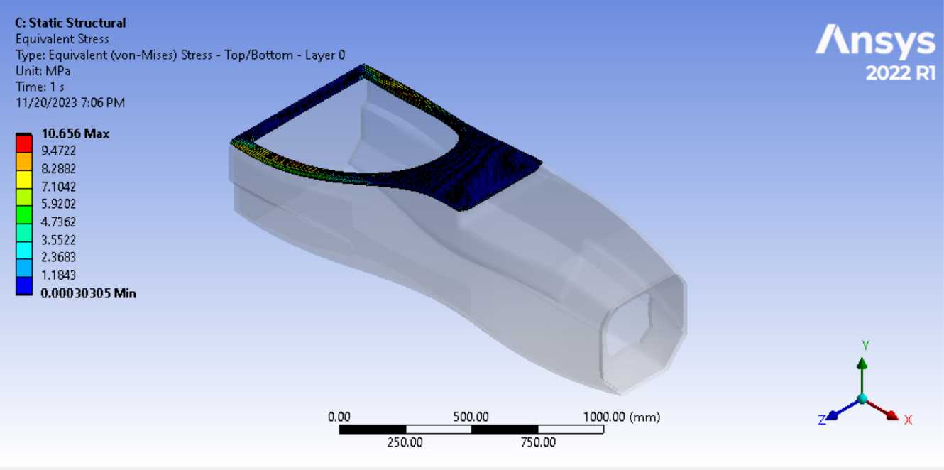
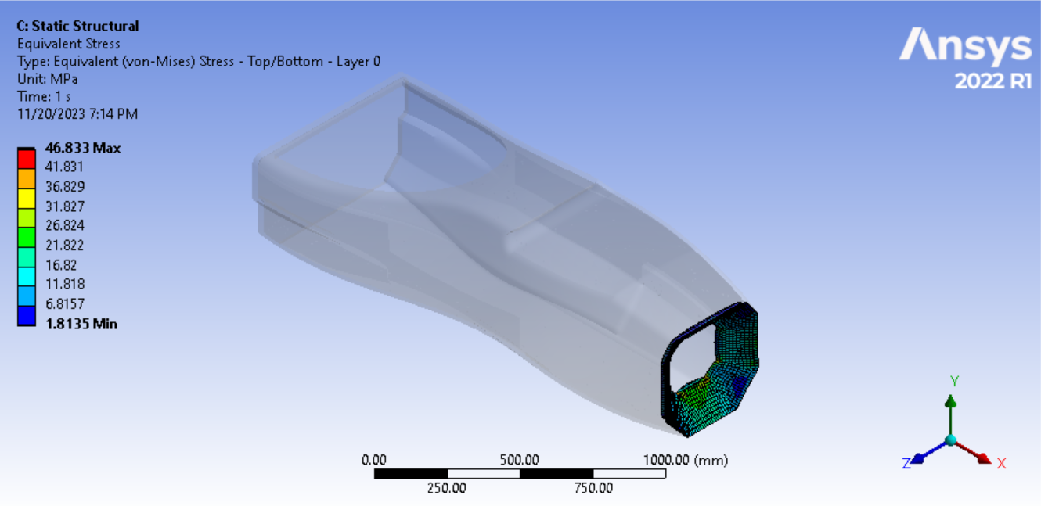
Analysis of Frontal Impact
Equivalent Stress
Fixed nodes
Direction of force

Slide 16
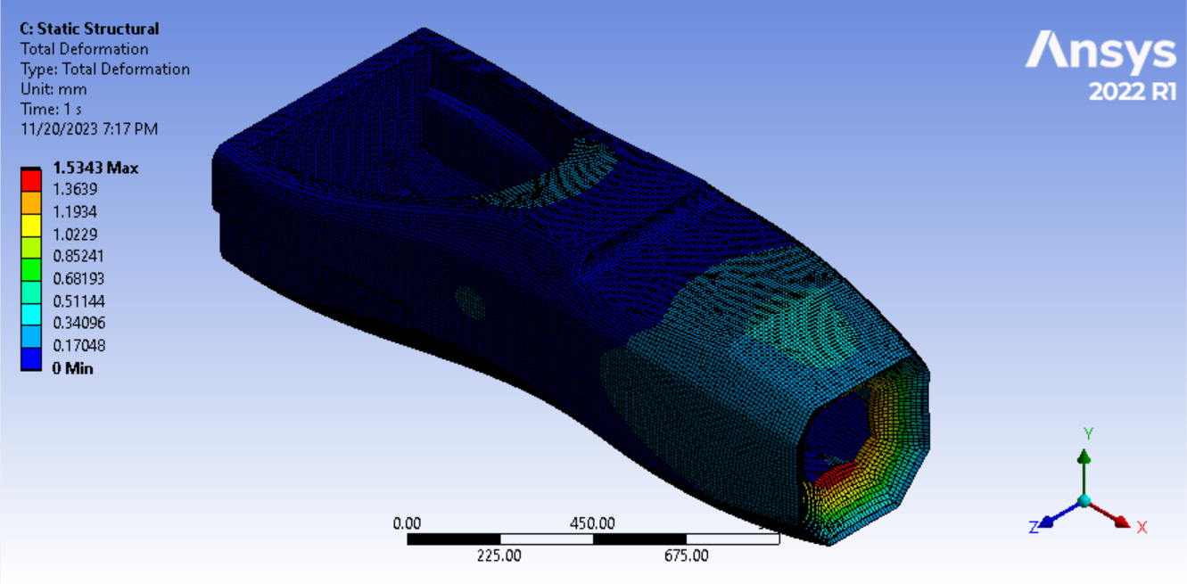
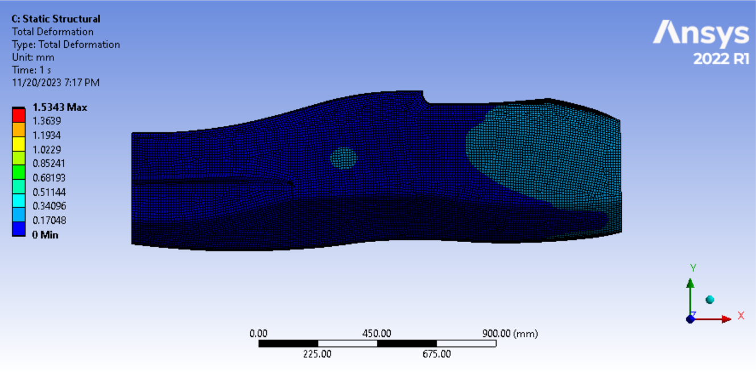
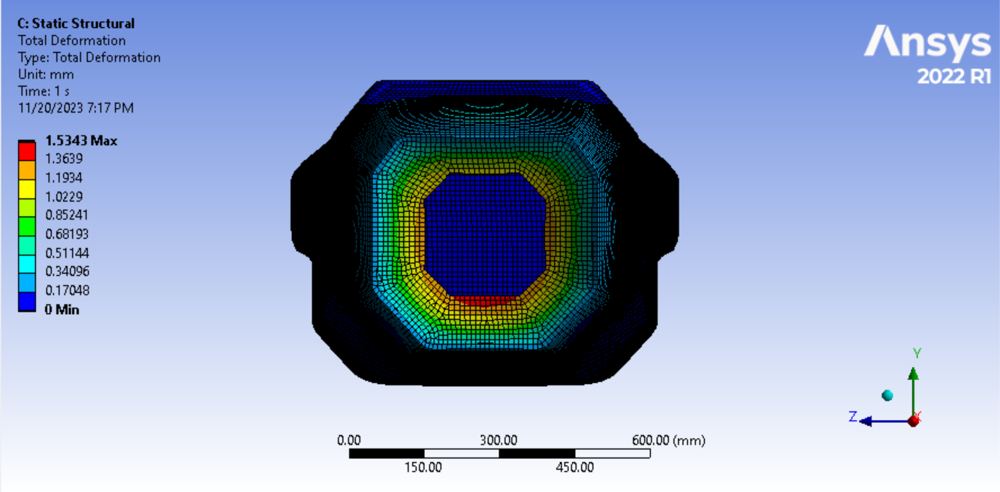
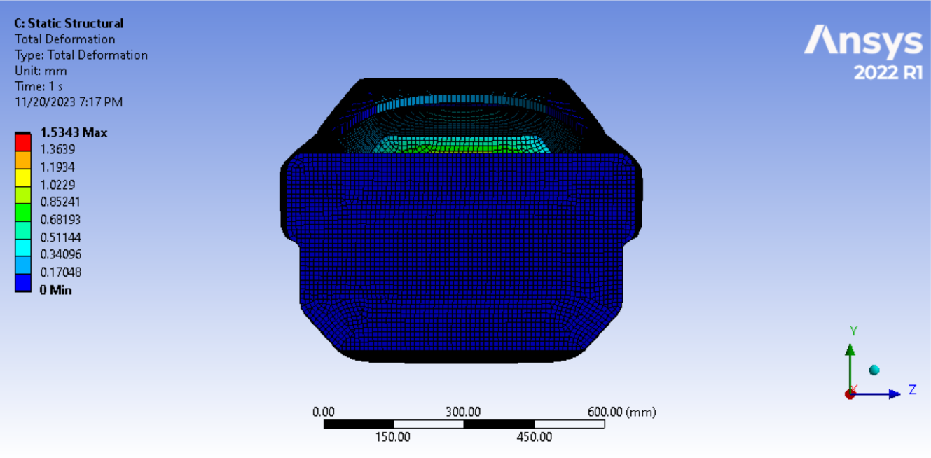
Total Deformation

Slide 17
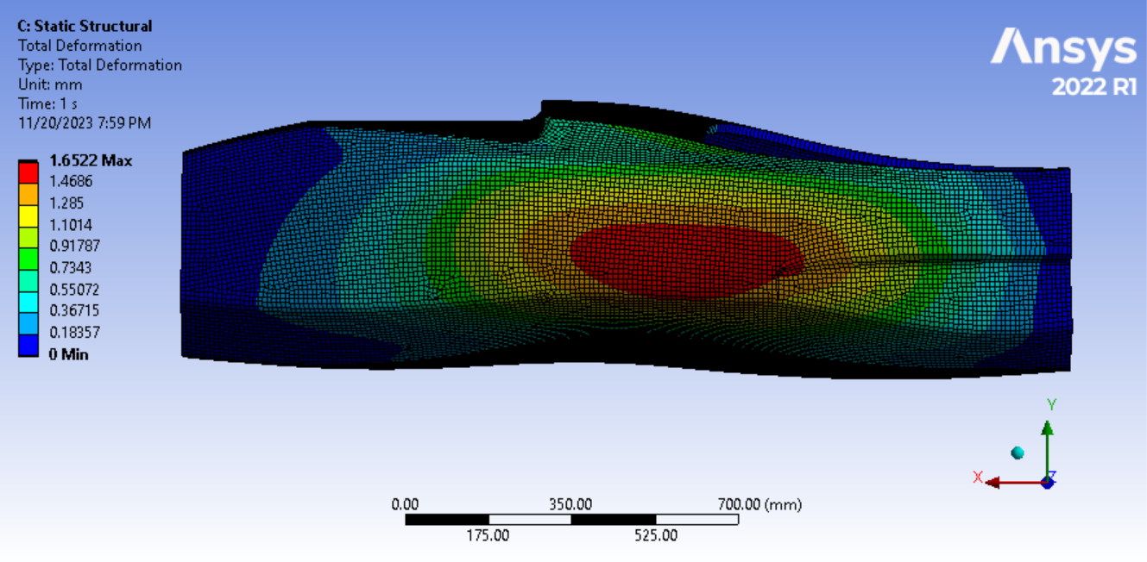
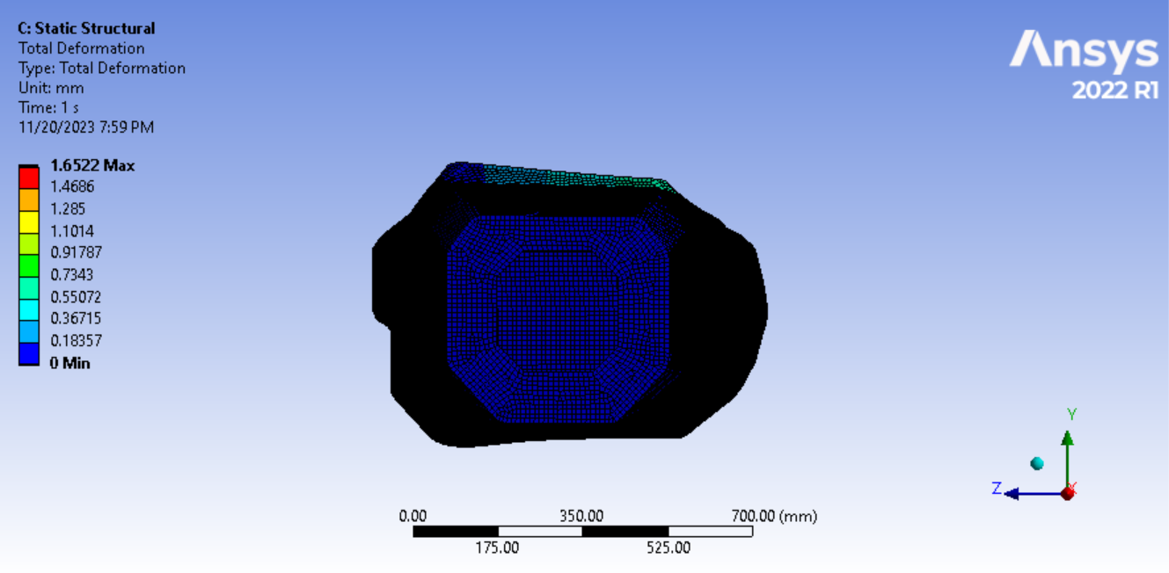
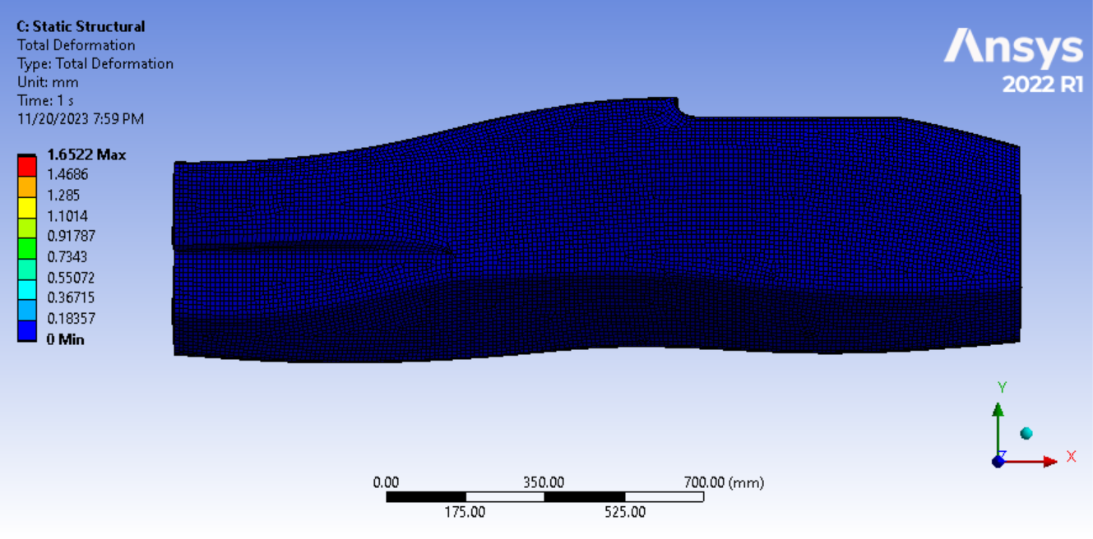
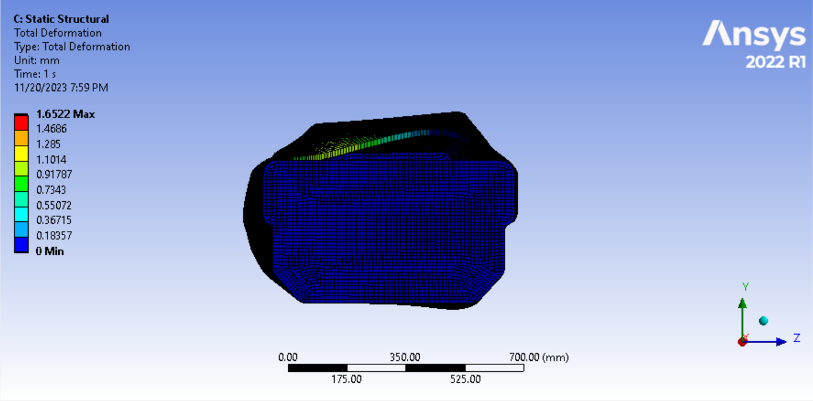
Analysis of Side Impact
Total Deformation
Fixed nodes
Direction of force

Slide 18
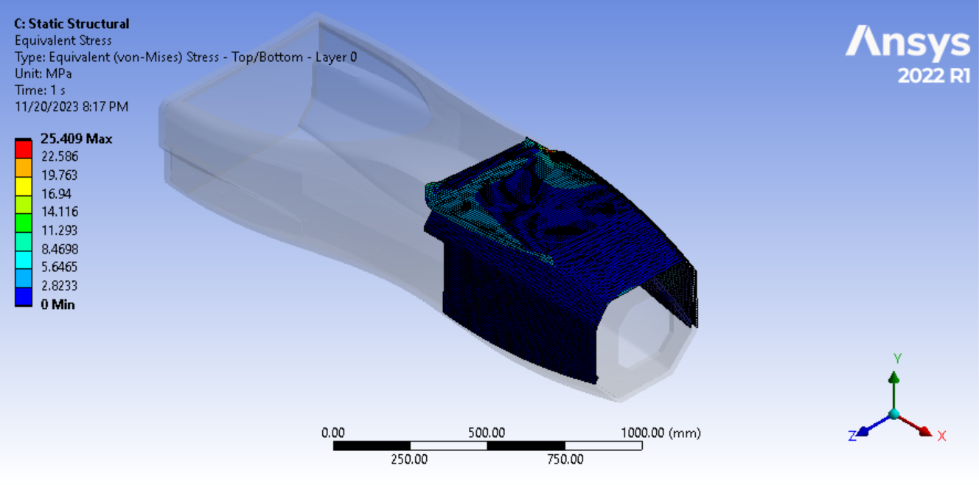
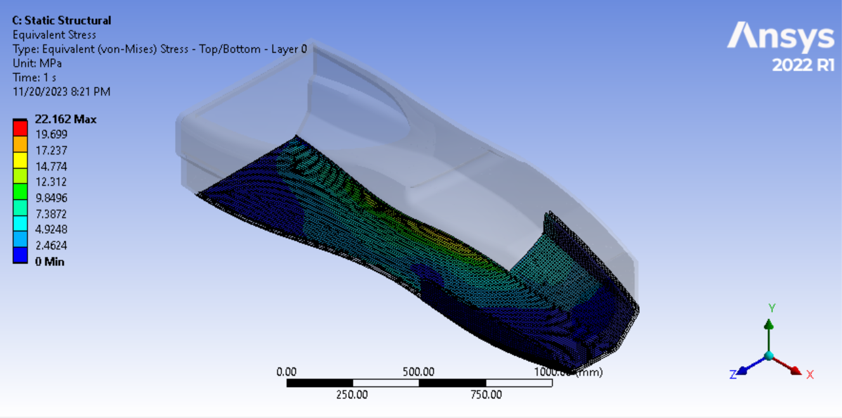
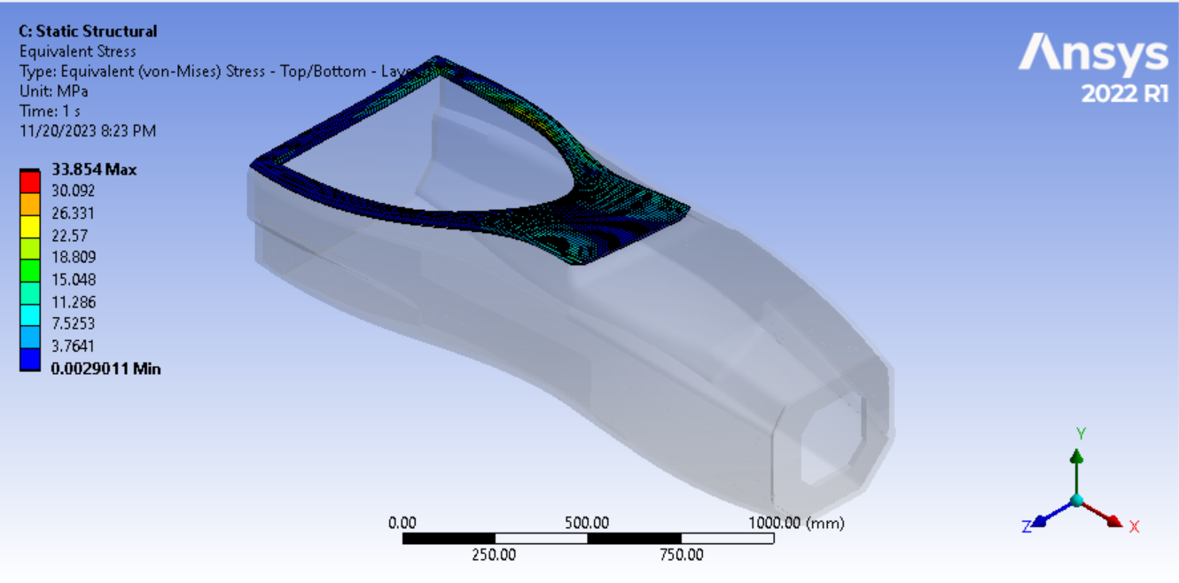
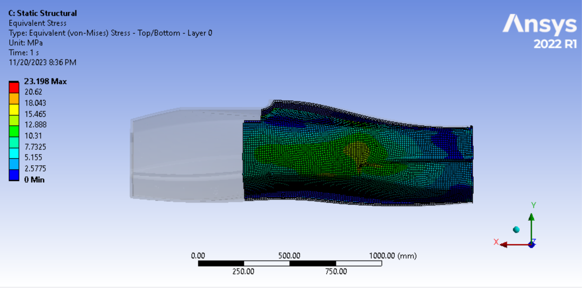
Equivalent Stress

Slide 19
Material Selection
Properties | Hexcel M35-4 3K Twill 2x2 | Gurit SE 84LV HEC Unidirectional | Hexcel AS4 3K Twill 2x2 | Grafil TR50S Unidirectional
Area Density | 346 g/m2 | 477 g/m2 | 388 g/m2 | 251 g/m2
0° Tensile Strength | 950 MPa | 2458 MPa | 1102 MPa | 2950 MPa
0° Compressive Strength | 900 MPa | 1354 MPa | 950 MPa | 1600 MPa
90° Tensile Strength | 950 MPa | 39.2 MPa | 1102 MPa | 79 MPa
90° Compressive Strength | 900 MPa | N/A | 950 MPa | N/A

Slide 20
Core Materials
Material Properties | PN1 Nomex Honeycomb | 5056 Aluminum Honeycomb | Standard Balsa Wood | Heavy Weight Balsa Wood
Cell Size | 1/8" | 1/8" | N/A | N/A
Thickness | 1/2",1” | 1” | 1” | 1”
Density | 4.1 lb/ft3 | 3.1 lb/ft3 | 9.5 lb/ft3 | 17.5 lb/ft3

Slide 21
Conclusion
Our design has been improved upon and changed from our prior iteration.
We simulated each of them as well and obtain the desired results.
The FOS of all components reached an acceptable level (i.e more than 1.5 times).
The COG reading falls within the range of 250 to 320 mm, which is suitable for our 60-degree tilt test.
After benchmarking all the materials which are used by other teams and some other materials found through research .It is suggested that the team uses Hexcel AS4 3K Twill 2x2 where draping is required and at the places where there are flat surface Gurit SE 84LV HEC Unidirectional.

Slide 22
References
Referred Book: Race car vehicle Dynamics by William F. Milliken and Douglas L.
Milliken:https://iopscience.iop.org/article/10.1088/1742-6596/908/1/012042/meta
.Ergonomics:https://www.ijert.org/research/determination-of-ergonomics-for-formula-student-vehicle-IJERTV6IS030536.pdf
Hexcel AS4 3K Twill 2x2:https://www.hexcel.com/user_area/content_media/raw/AS4C_Industrial_HexTow_DataSheet.pdf
Gurit SE 84LV HEC Unidirectional:
https://www.amtcomposites.co.za/wp-content/uploads/2021/06/se-84lv.pdf
Grafil TR50S Unidirectional
https://www.rockwestcomposites.com/media/wysiwyg/Product_Categories/Materials_Tools/TR50S_12K_-_14046_Fiber.pdf

Slide 23
Thank you

